Slide 1

Connex One: Task Review
Alex Lay

Slide 2



Agenda
Task Review
EDA
Preprocessing
Modelling
Results

Slide 3
Task Review:
Five Key TaskS:
Identify any highly correlated pairs of variables
Develop Model A that given variables 1-20 predicts the probability of a client subscribing to the bank term deposit.
Identify a variable which is most predictive of the client’s subscription.
Develop Model B that uses only 5 variables to predict whether a client will subscribe to the bank term deposit or not.
Compare the performance of Model A vs Model B.

Slide 4
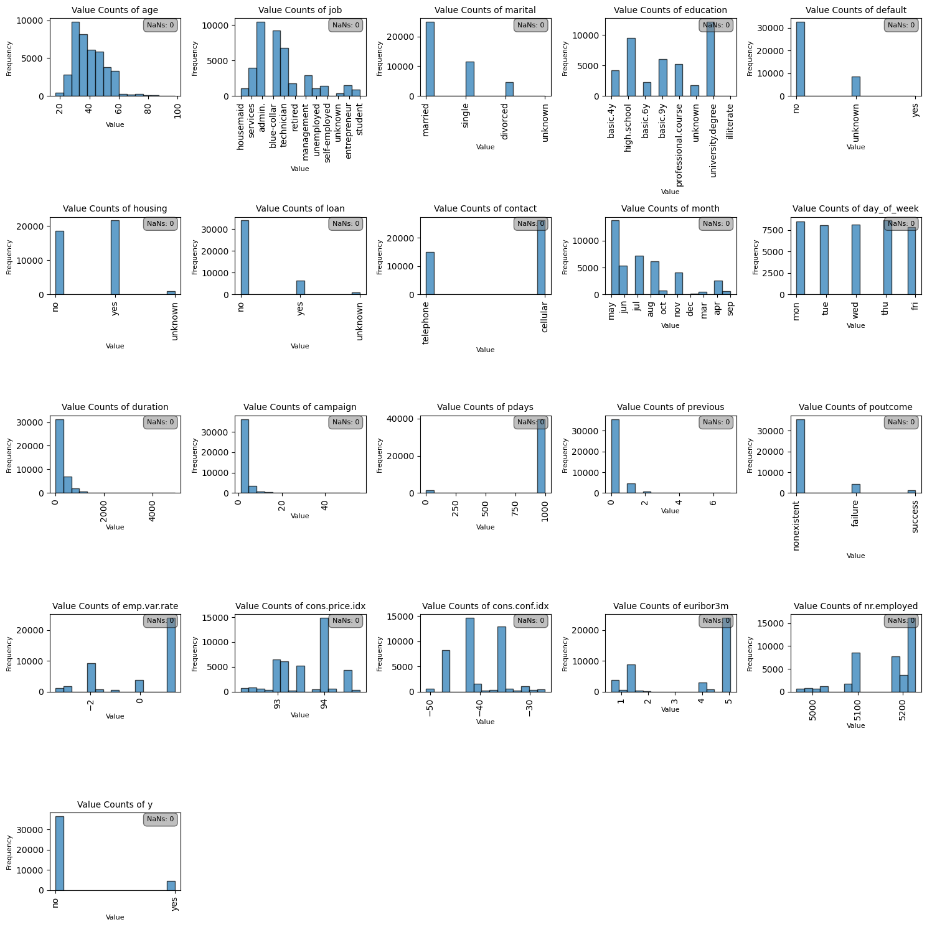
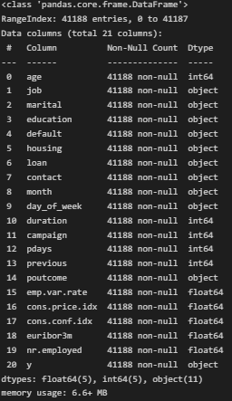
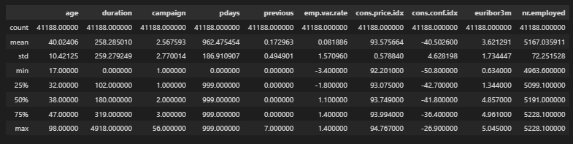
EDA – First Look

Slide 5
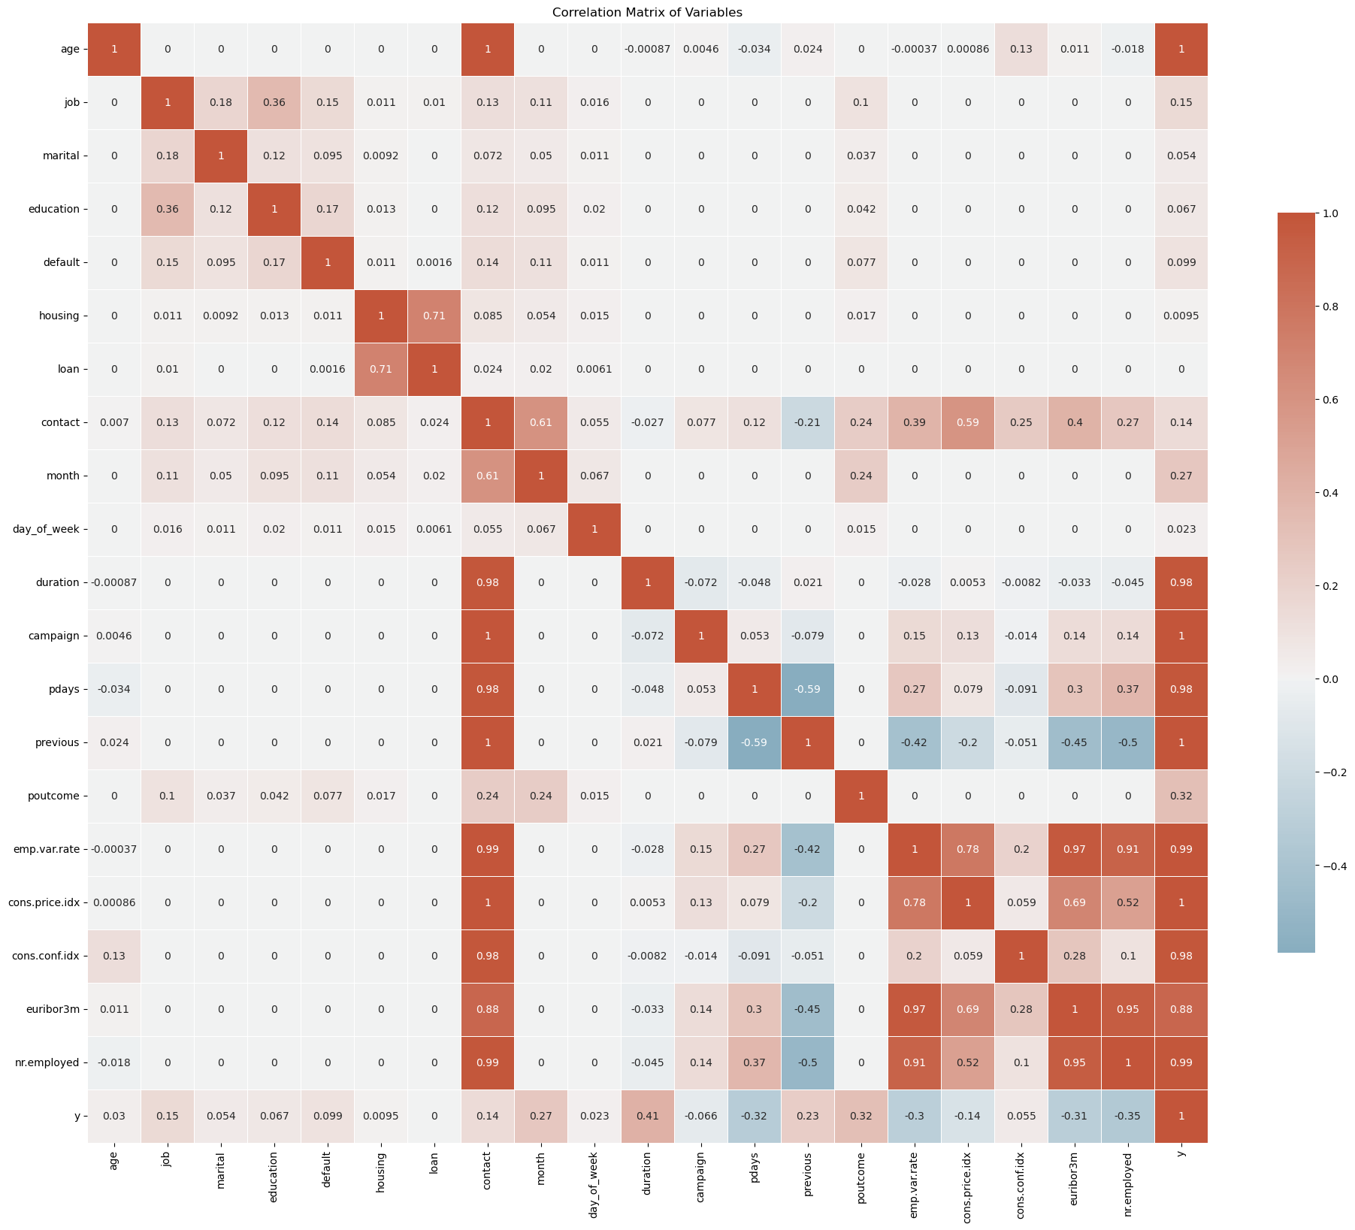
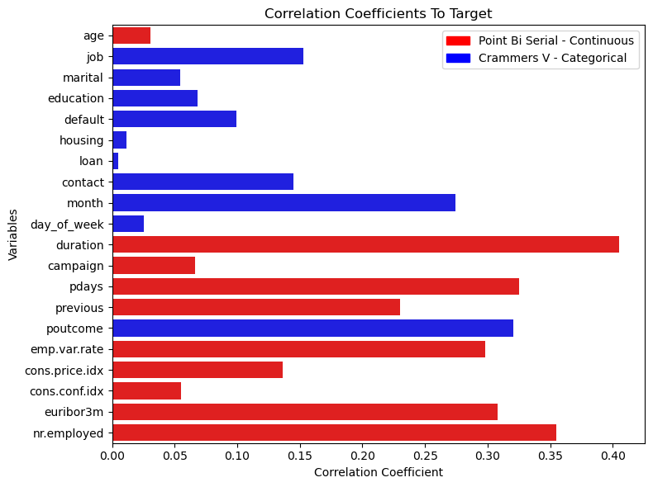
EDA - Correlations

Slide 6
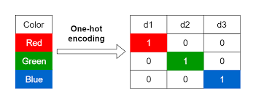
Preprocessing:
Load the data
Split the data into an 80-20
One hot encode features (only for some algorithms)
Binary encode target

Slide 7
Metrics:
Metric | Calculation | Interpretation
Accuracy |  | It gives a general idea of a model's overall performance but can be misleading in imbalanced datasets.
AUC (Area Under Curve) |  | It quantifies how well a model distinguishes between classes, with 1 indicating perfect prediction and 0.5 representing no discriminative power.
Precision |  | It indicates the accuracy of positive predictions, emphasising the cost of false positives.
Recall |  | It measures a model's ability to detect positive cases, highlighting the cost of false negatives.
F1 |  | Useful when the class distribution is uneven, assessing a model's accuracy in identifying positive cases.
AUC Precision - Recall |  | Useful in imbalanced datasets, measuring a model's ability to distinguish the positive class amidst many negatives.

Slide 8
Modelling: Model Selection
Model | Accuracy | AUC | Precision | Recall | F1 | AUC PR
KNN | 0.91 | 0.92 | 0.62 | 0.46 | 0.53 | 0.6
Naive Bayes | 0.83 | 0.51 | 0.13 | 0.08 | 0.1 | 0.12
Logistic Regression | 0.83 | 0.51 | 0.13 | 0.08 | 0.1 | 0.12
XGBoost | 0.91 | 0.94 | 0.62 | 0.56 | 0.59 | 0.62
LGBoost | 0.91 | 0.95 | 0.62 | 0.56 | 0.59 | 0.66
CatBoost | 0.92 | 0.95 | 0.65 | 0.55 | 0.6 | 0.65

Slide 9

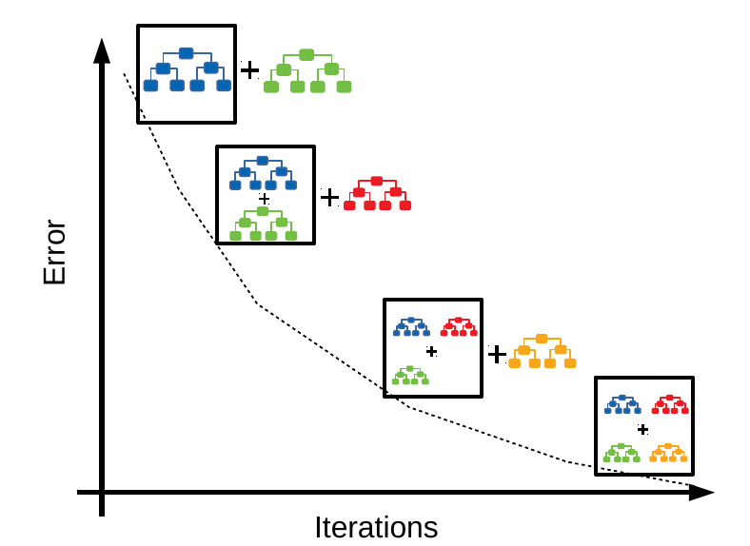
Modelling: CatBoost
A machine learning technique for regression and classification problems, which builds a model in a stage-wise fashion.
Uses weak models (stumped or shallow trees) to predict the error of the previous iteration. Adding trees each time and predicting previous error is foundation of the boosting method.
CatBoost has specialised mechanisms for handling categorical data and reduces overfitting more effectively.

Slide 10


Modelling: Hyperparameters and Class Issue
Used Optuna Bayesian method to tune hyperparameters due to computational speed.
Trialed several methods to adjust for the class imbalance. Settled on tuning ‘scale_pos_weight’ parameter try to improve Recall and F1 score along with SMOTE for up sampling.
Evaluation metric for Optuna was combination of F1 score for validation set and RMSE between train and test to reduce over/under fitting.

Slide 11
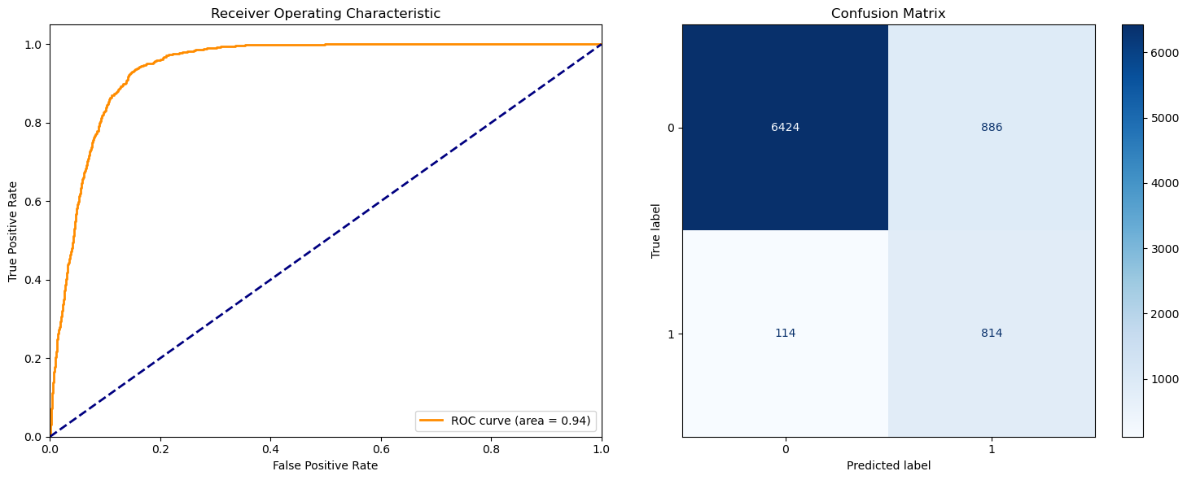
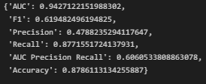
Results: Full Model

Slide 12
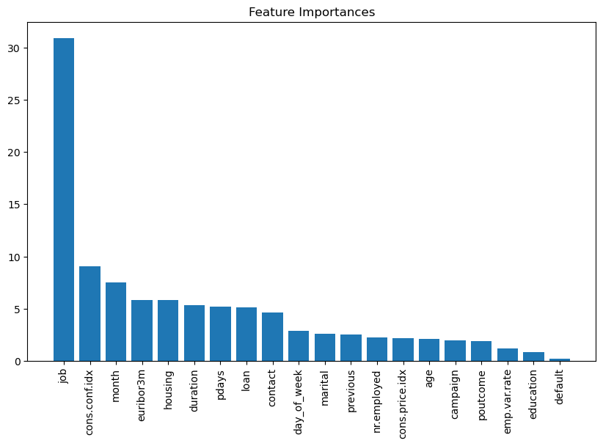
Results: Feature Importance

Slide 13
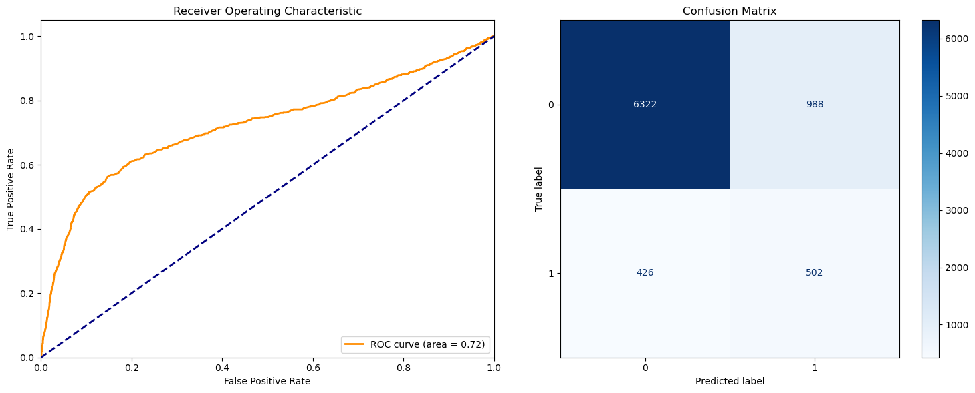
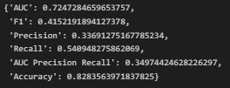
Results: Top Five Model

Slide 14
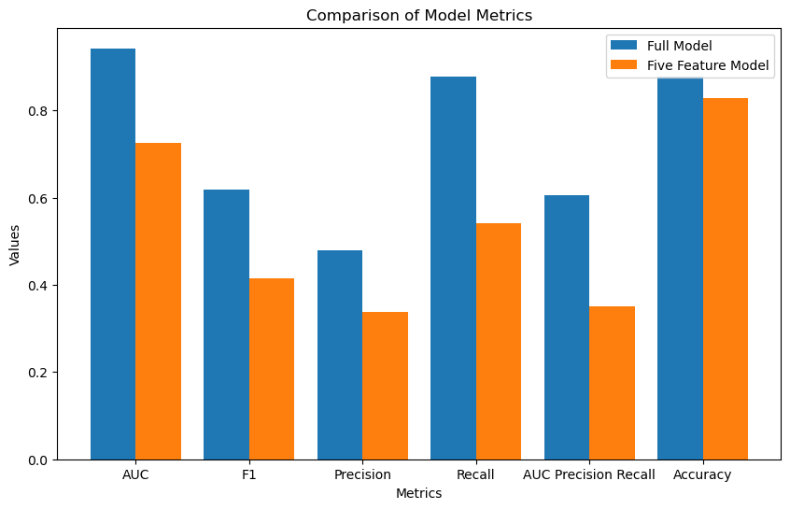
Results: Comparison

Slide 15
Future Work:
Trial longer Optuna training times
Look into creation of new features based on existing.
Look into PCA and combination of existing features to reduce feature space
Trial Deep Learning model
Extract the tree plot from CatBoost to interpret the model

